Slide 1
Cs602 Term Project
Qi Hu

Slide 2
Overview and Configuration
PHP 5.6.31, XAMPP V3.2.2(Only can implement on PHP 5.5&5.6)
[mysql_connect() can not implement in latest version of PHP]
Login information:
1. Student sample: User Name: Alexander Password: 111
2. Teacher sample: User Name: Blake Password:111
3. Administer sample(Additional function):
User Name: admin Password:111

Slide 3
Database Configuration
Cs 602.sql
Source Server : localmysql
Source Server Version : 50617
Source Host : localhost:3306
Source Database : cs602
Target Server Type : MYSQL
Target Server Version : 50617
File Encoding : 65001

Slide 4
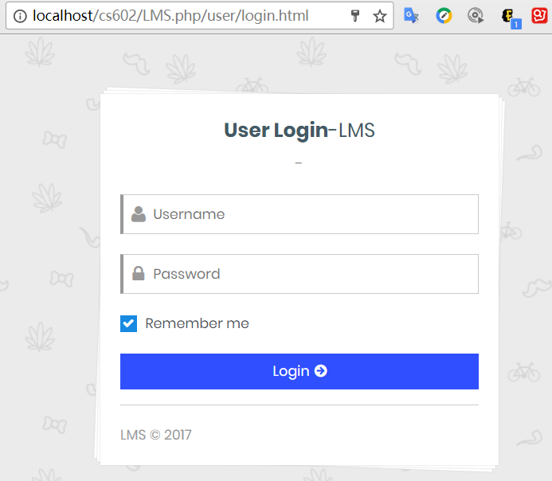
User guide book of LMS
Login interface
Localhost/cs602/LMS.php

Slide 5
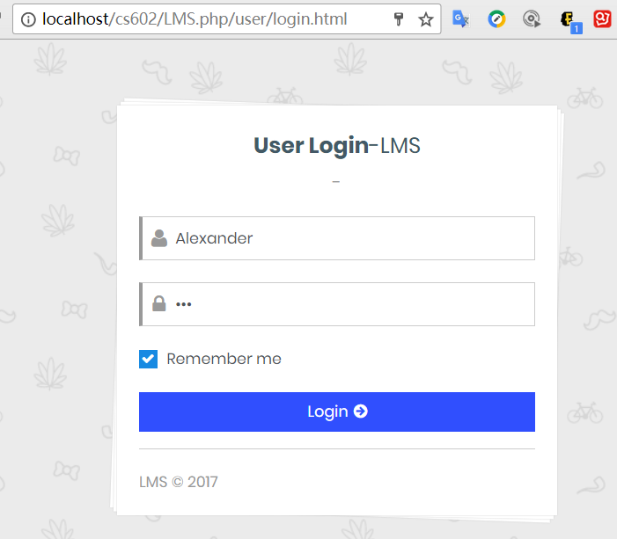
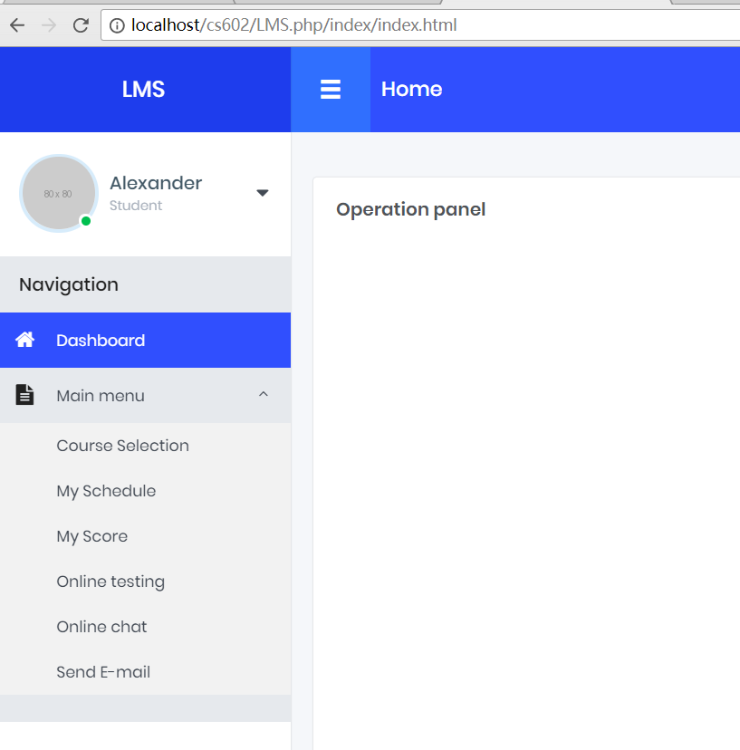
Students part
Login LMS as a student

Slide 6
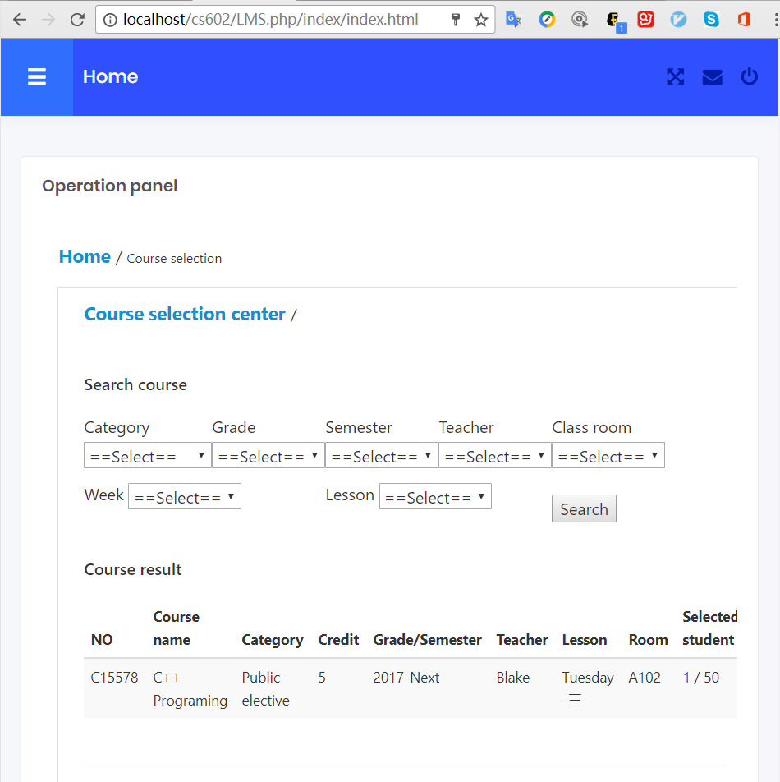
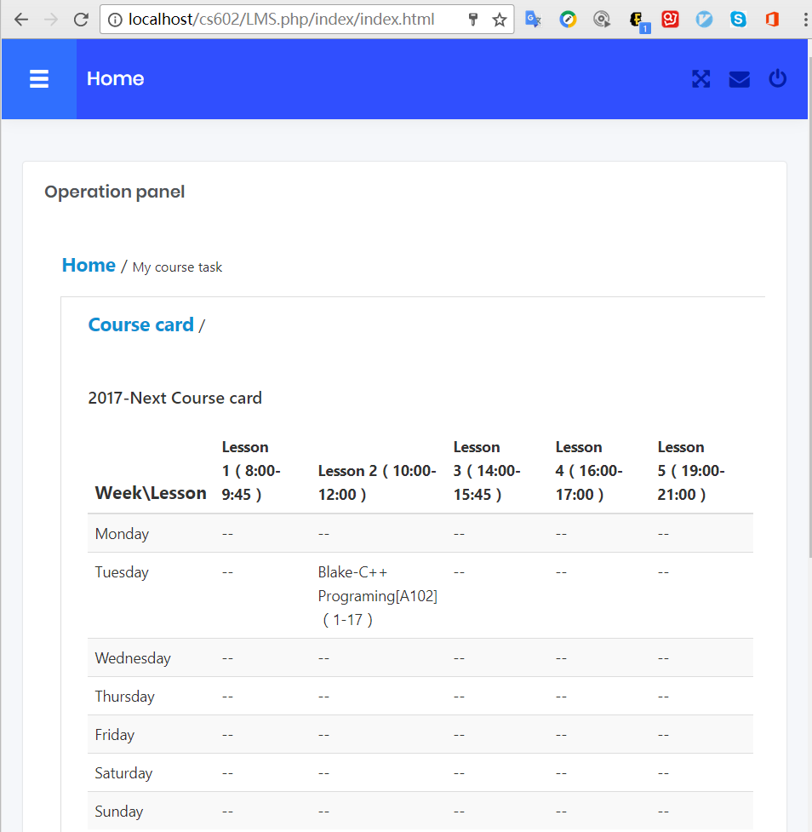
What students can do in LMS
1. Select the course 2. Then check the schedule

Slide 7
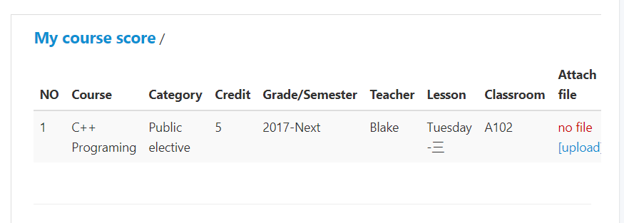
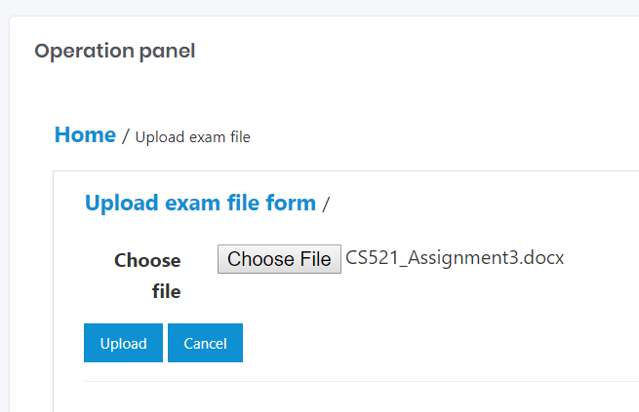
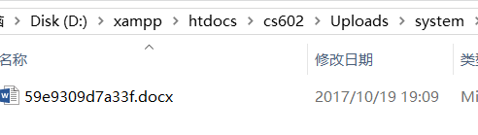
Assignment and Score
Interface
Upload your assignment

Slide 8
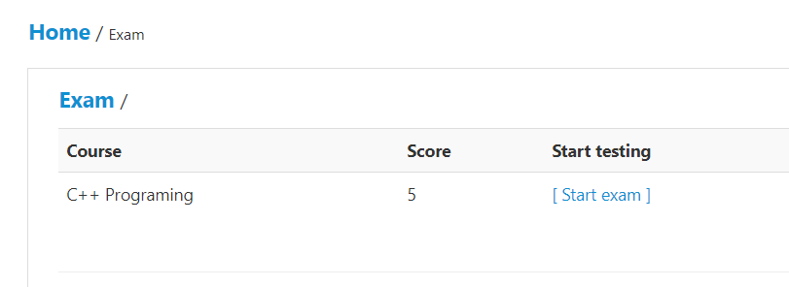
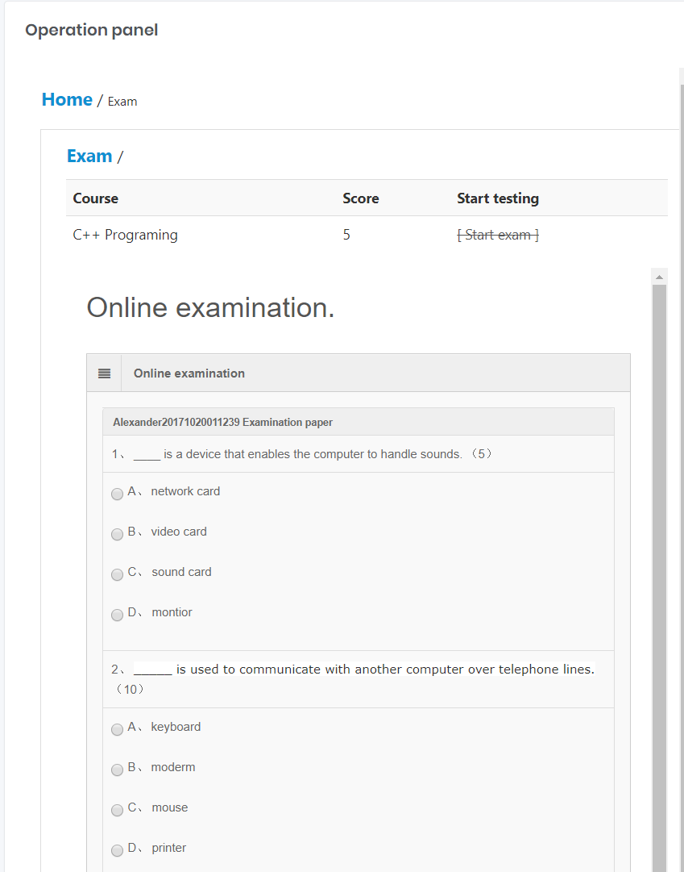
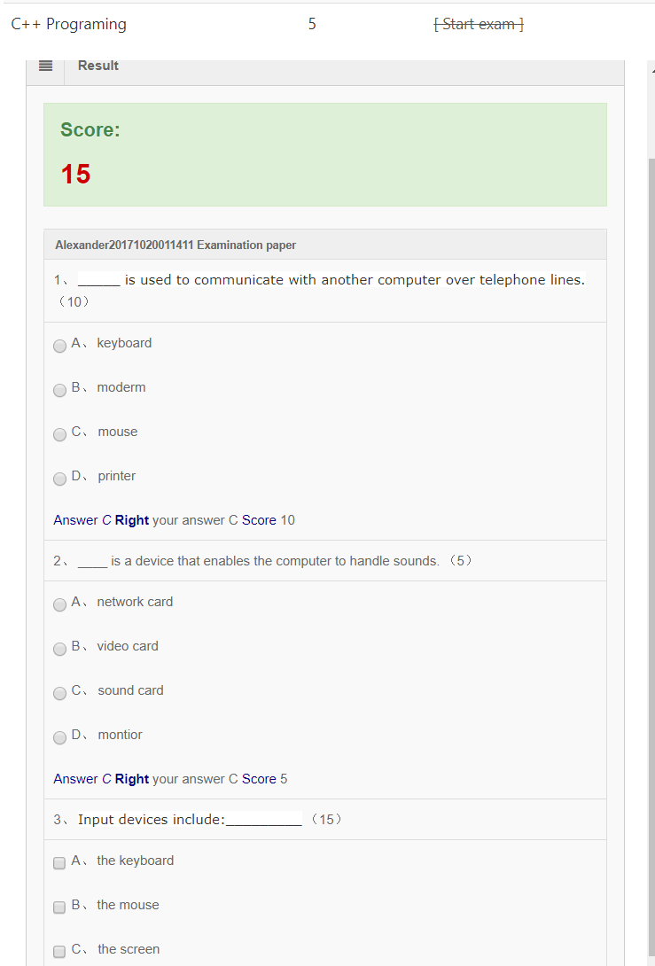
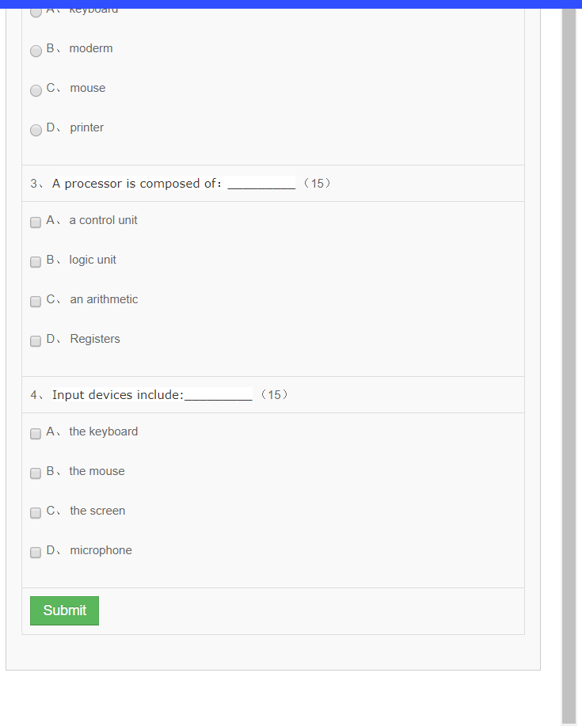
Take the quiz online

Slide 9
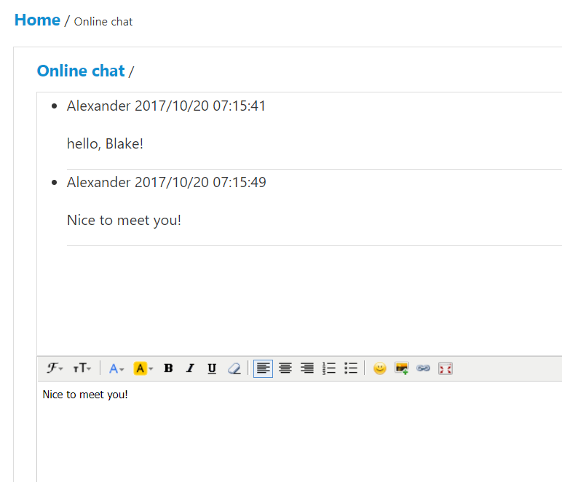
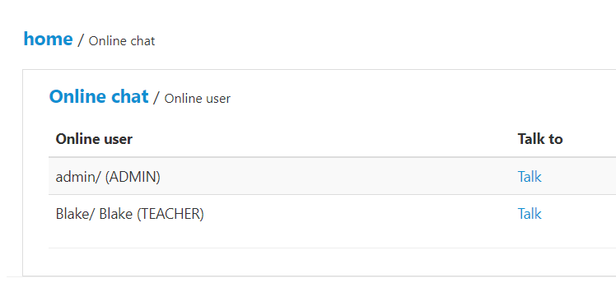
Chat with each other (Discussion)

Slide 10
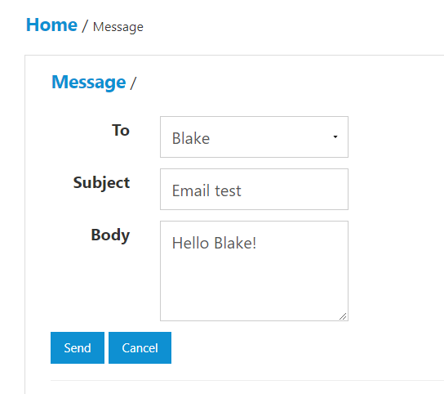
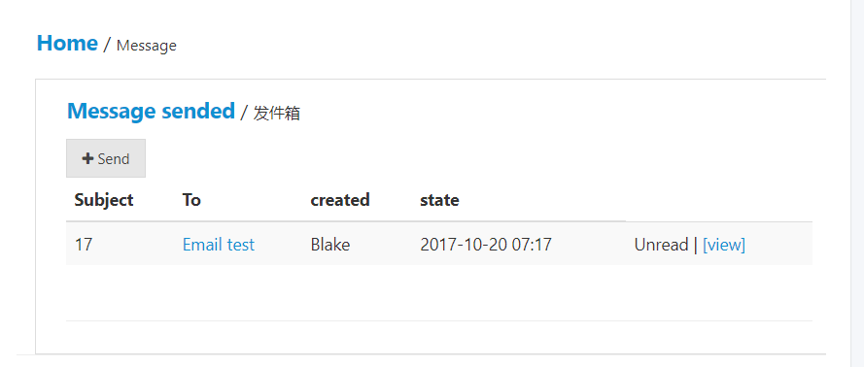
Send Email to LMS users

Slide 11
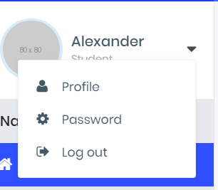
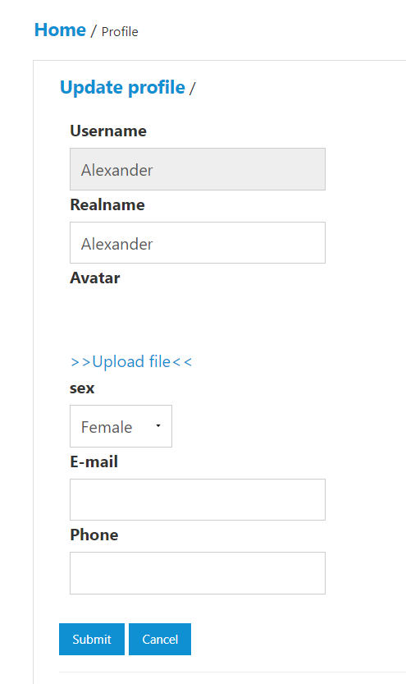
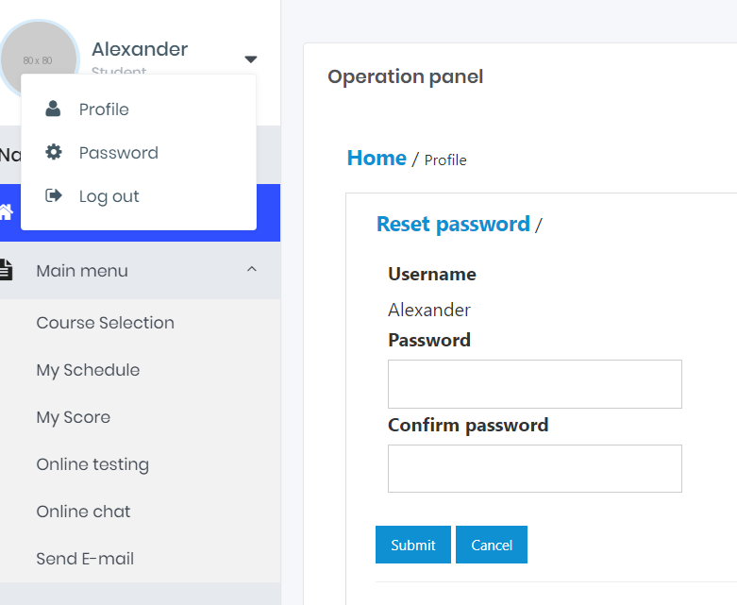
Some additional features!
Upload your profile
Change your password

Slide 12
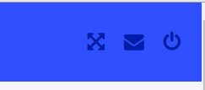
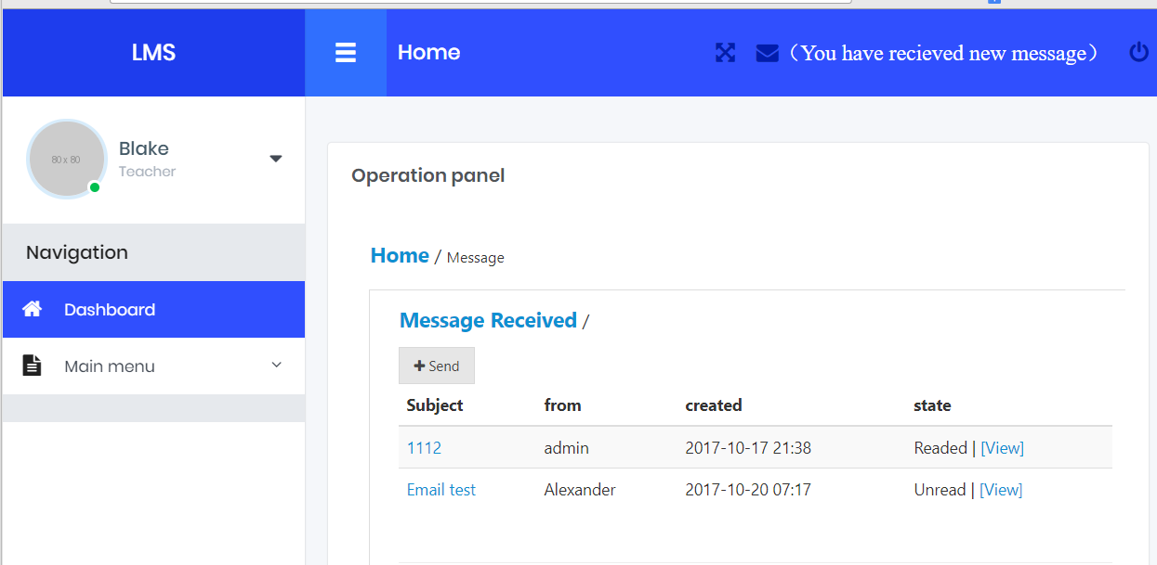
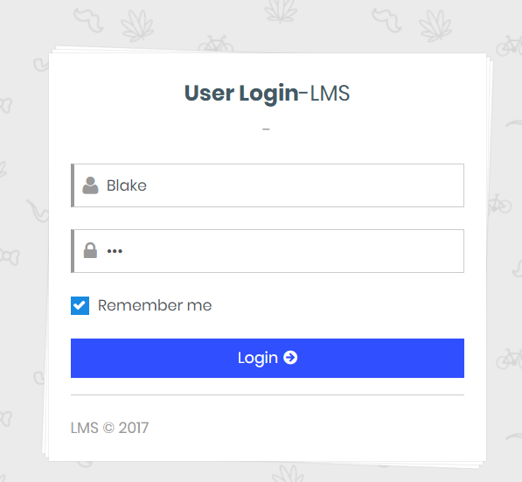
If you are the instructor, teacher and professor, more works you can do in LMS!
Click the button at the right of the header to logout, and login as Professor Black! You will see the Email send from Alex!

Slide 13
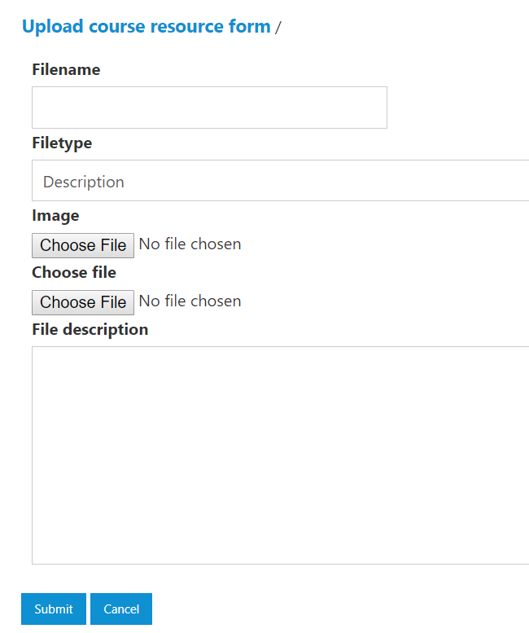
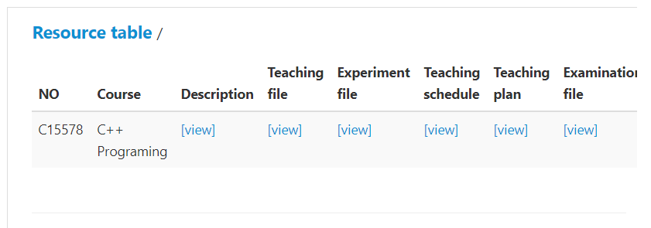
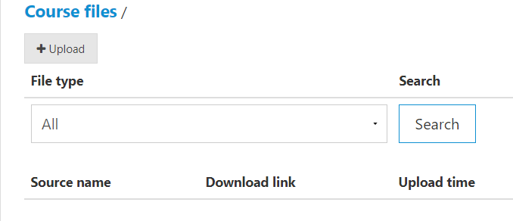
Differences features with Students part
Source list
Upload your own courses materials and manage in LMS

Slide 14
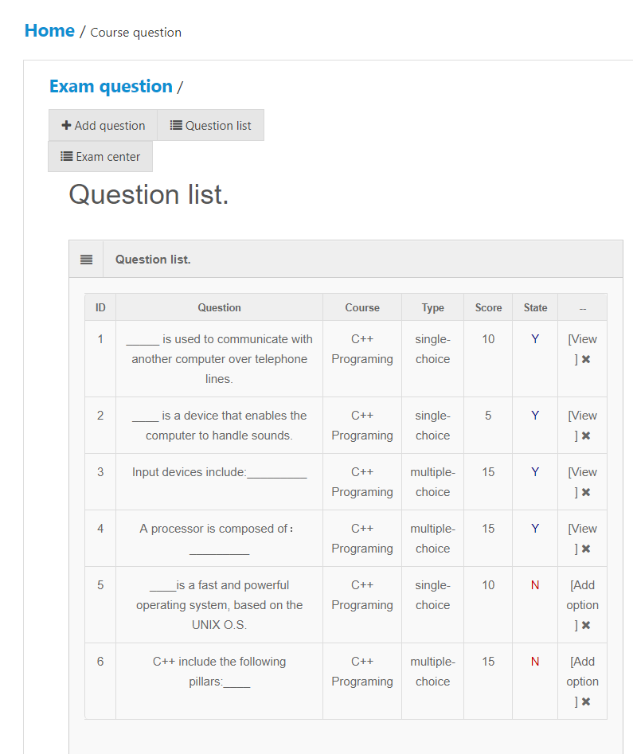
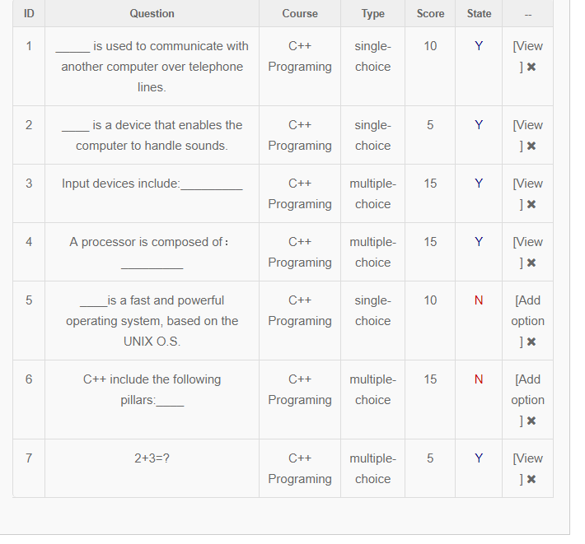
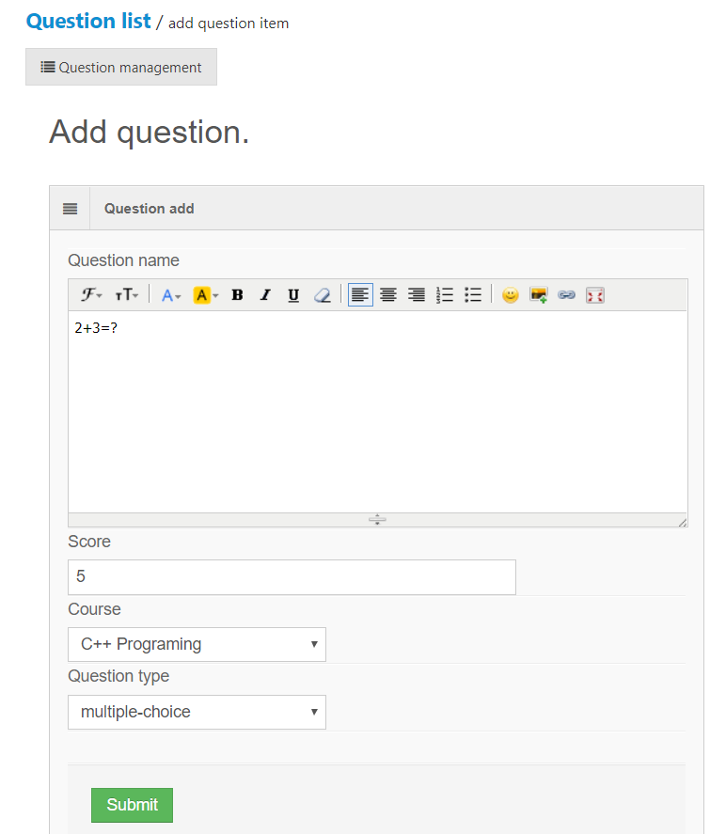
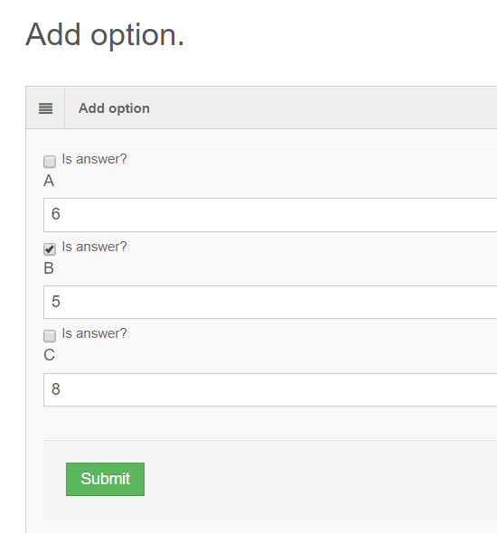
Quiz part
Quiz view
Add the questions!

Slide 15
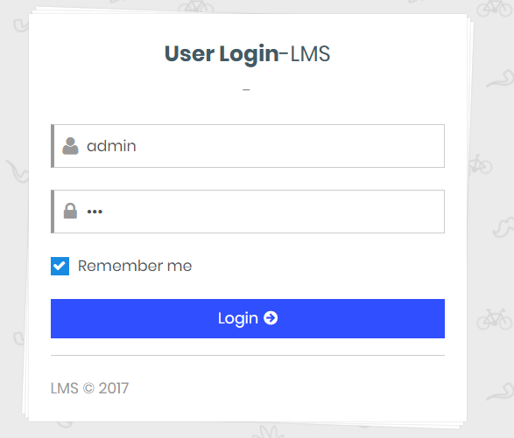
Manage this system?
Login as admin

Slide 16
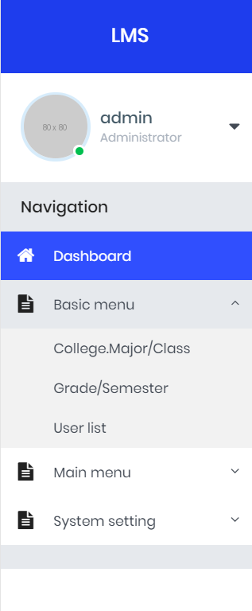
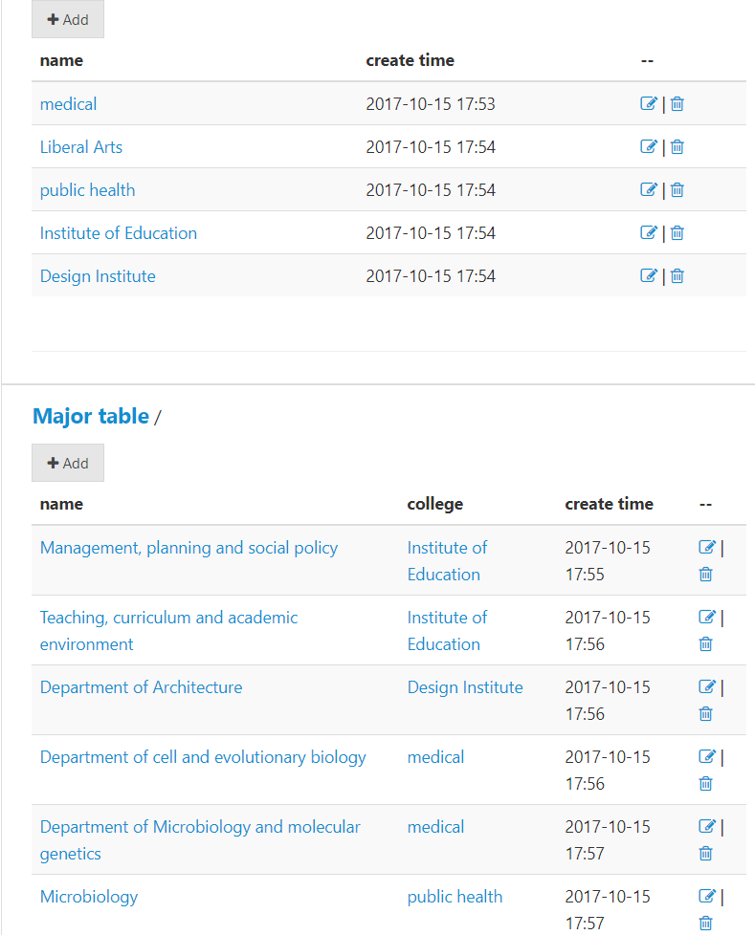
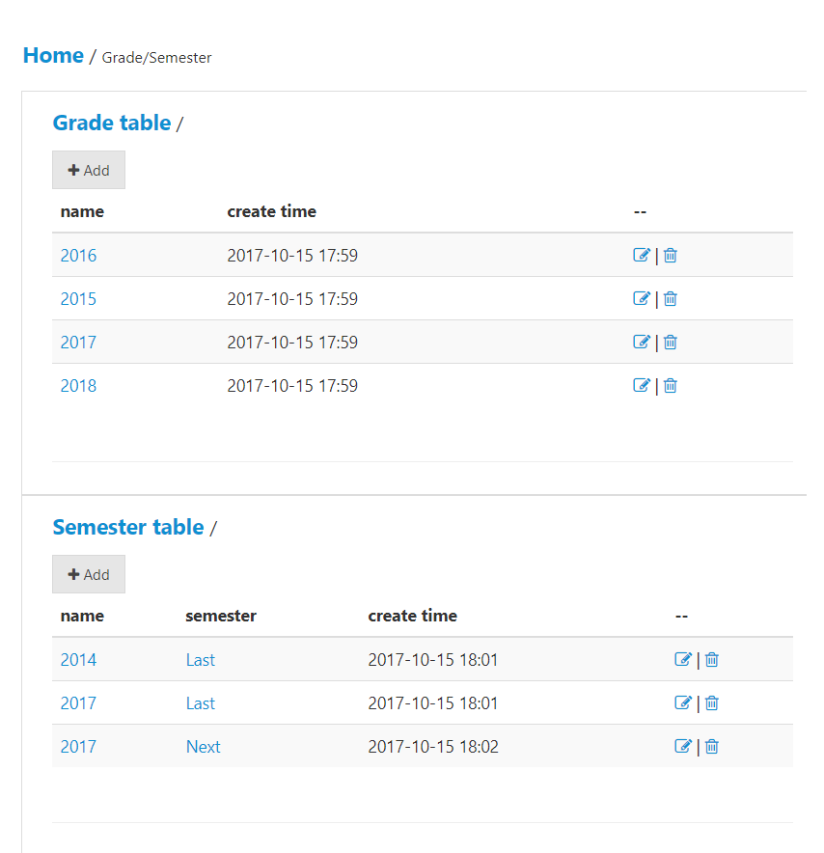
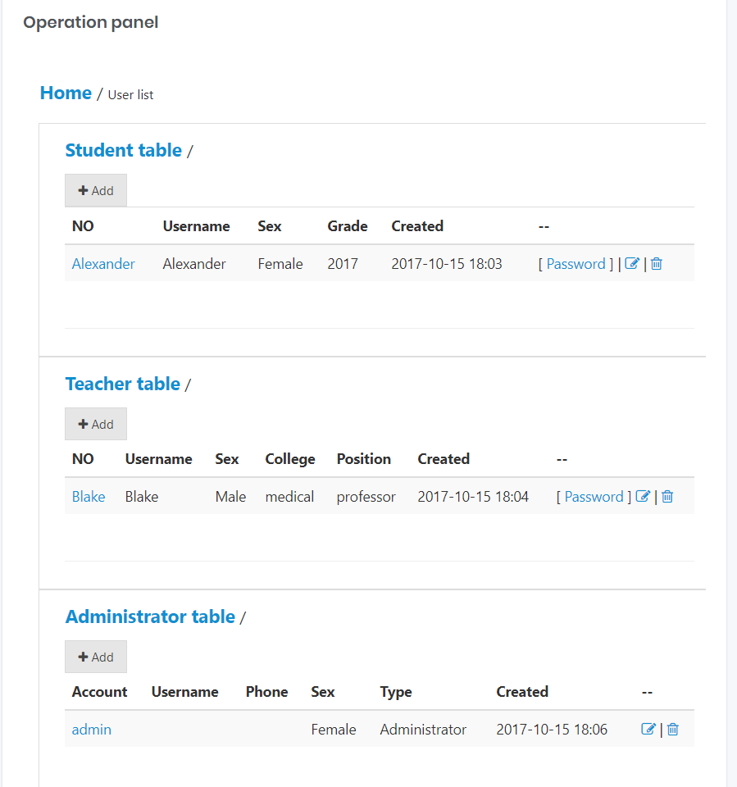
Manage colleges, courses, semesters and users

Slide 17
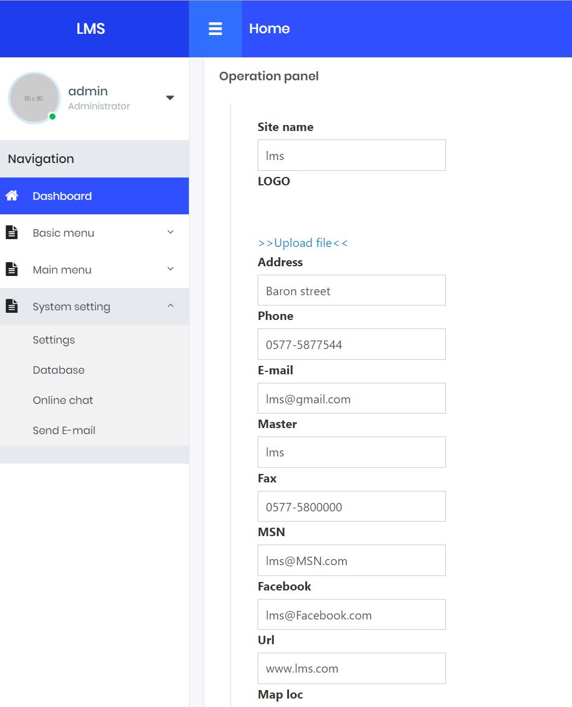
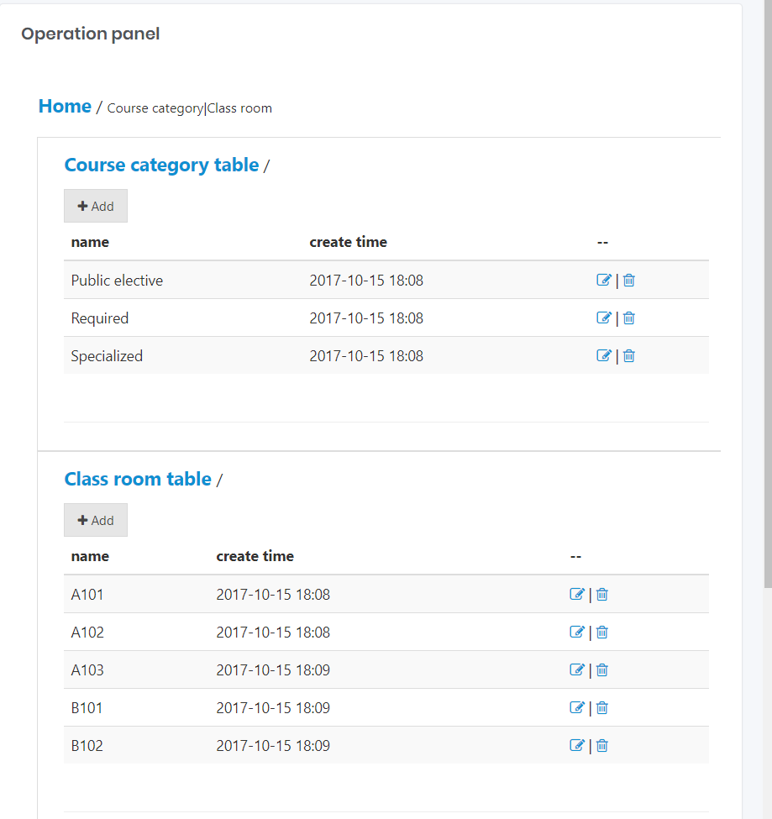
Also, Classroom and credit of courses and LMS system

Slide 18
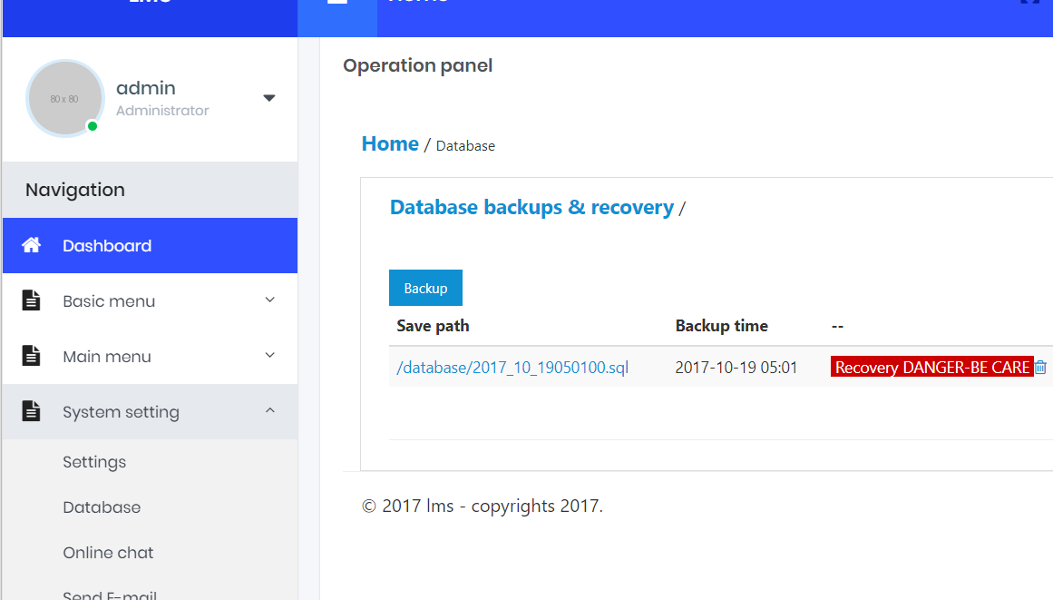
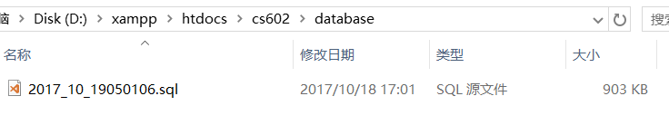
Database Backup

Slide 19
Try LMS yourself! Thank you!
Qi Hu

